Slide 1
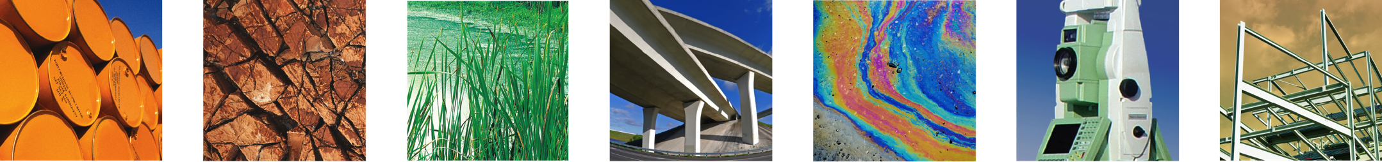
Swiss Re and the Association of Average Adjusters of the United States and Canada
in Association with NYMAR and The Propeller Club, Chapter of the Port of New York / New Jersey
“Mega Container Ship Casualties Seminar”
New York, NY

Slide 2
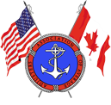
Mega Container Ships:
The Potential Environmental Issues Associated with Large Container Ship Casualties
Presented by:
Lawrence Malizzi, PG
March 21, 2014

Slide 3
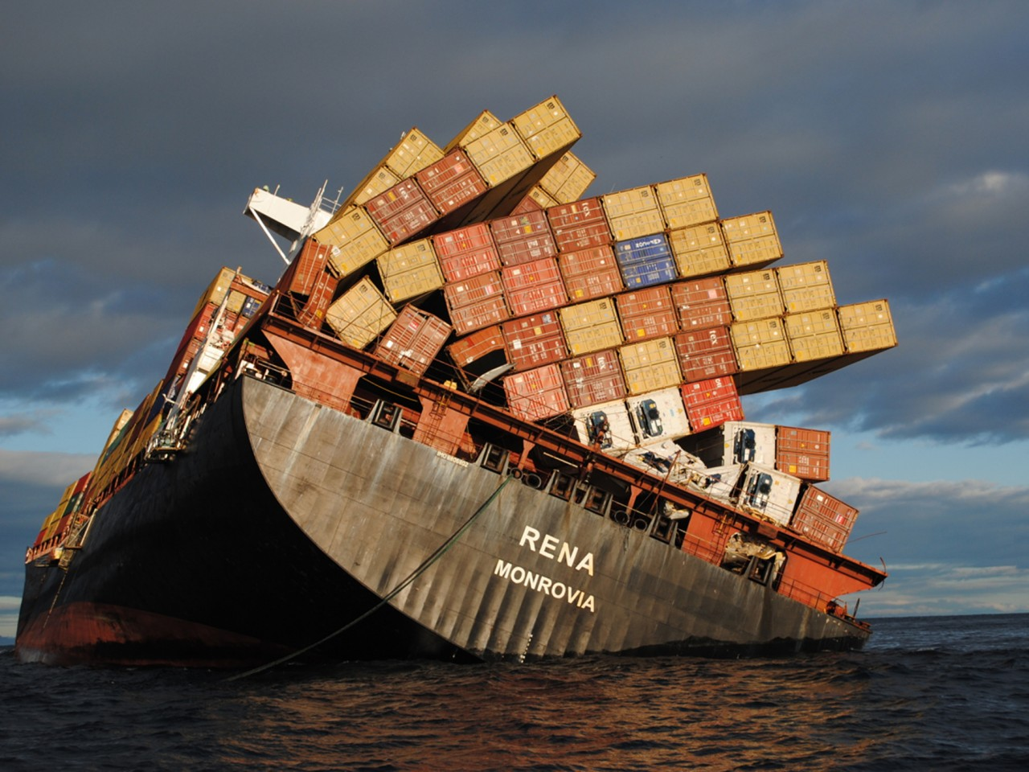
October 1, 2012 (AP) — A Greek shipping company has agreed to pay the New Zealand government up to $31.5 million toward the cleanup costs of a cargo ship’s grounding on a reef near popular swimming and surfing beaches last year. But taxpayers will still be footing some of the bill.

Slide 4
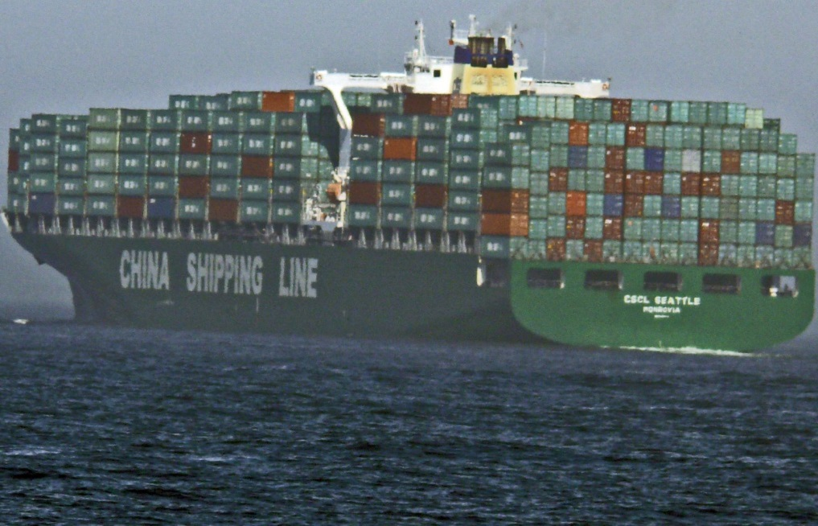
Environmental Exposures
Bunkers
Vessel Operations
Cargo
Hull Damage
Oil

Slide 5
Bunkers

Slide 6
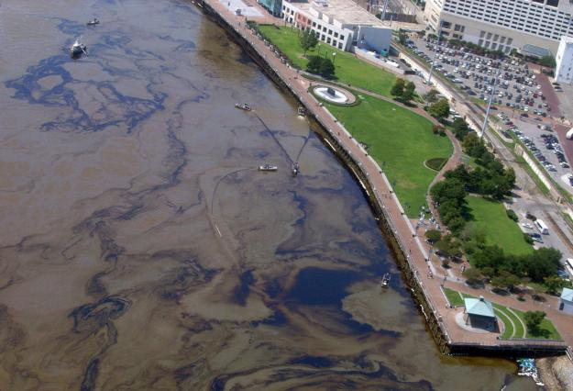
Oil Spills
International Convention on Civil Liability for Bunker Oil Pollution Damage (BUNKER)- Most Countries
Oil Pollution Act of 1990- US
Local Country and State Laws

Slide 7
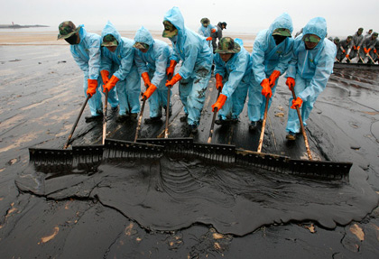
Spill Costs
Clean Up/Restoration
Third Party Claims
US- Natural Resource Damage Assessment (NRDA)
Oil

Slide 8
Bunker Volumes
An Example:
7000 Metric Tons of Bunkers (IFO 380) on a Mega Cargo Ship
1 MT = 6.35 Barrels = 266.7 Gallons
266.7 Gallons x 7000 = 1,866,900 Gallons
Oil

Slide 9
The Significance
Cosco Busan- San Francisco, California (2007):
53,000 gallons IFO 380
Cleanup costs: US $70M
NRDA: US $34M
NRDA costs: US $11M
Criminal fine: US $10M
Athos I- Philadelphia, Pennsylvania (2004):
265,000 gallons crude oil
Cleanup costs: US $267M
NRDA: US $27.5M
NRDA costs: US $3M
Oil

Slide 10
Vessel Operations

Slide 11
Regulations
International Convention for the Prevention of Pollution from Ships (MARPOL)
  Annex I- Regulations for the Prevention of Pollution by Oil
  Annex II- Regulation for the Control of Pollution by Noxious Liquid Substances in Bulk
  Annex III- Prevention of Pollution by Harmful Substance Carried by Sea in Package Form
  Annex IV- Prevention of Pollution by Sewage from Ships
  Annex V- Prevention of Pollution by Garbage from Ships
  Annex VI- Prevention of Air Pollution from Ships
US- Act to Prevent Pollution from Ships (APPS)
US Clean Water Act (CWA) & Resource Conservation and Recovery Act (RCRA)- Various Elements Enforced by US Environmental Protection Agency and US Coast Guard
MPRSA)
Oil

Slide 12
Regulations (cont.)
Various State Regulations- California leads the pack
Asbestos/Lead Paint
MPRSA)
Oil

Slide 13
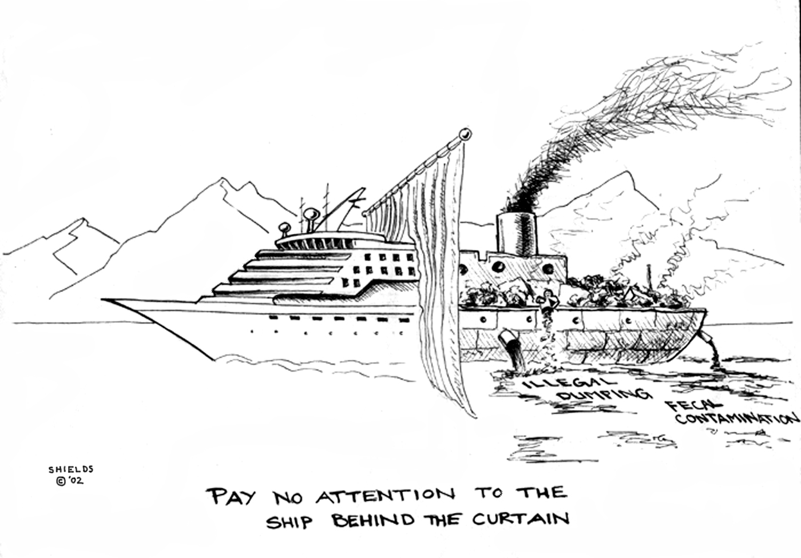

Slide 14
Cargo

Slide 15
Exposures
Storage/Segregation
Fire
Cargo Overboard/Vessel Sinking
Oil

Slide 16
Storage/Segregation
Questions:
Do you know what is in the container?
Do you know where the container is?
Do you know the compatibility of stored materials with each other and with with sea water?
  Fire
  Explosions
  Hazardous Vapors
Oil

Slide 17
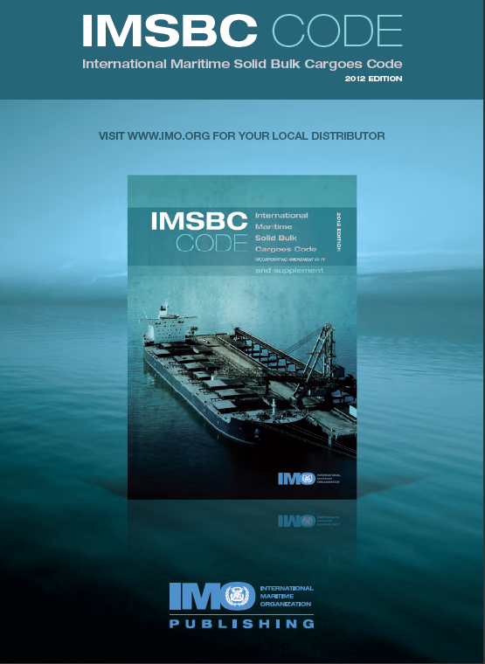

Slide 18
MARPOL Annex V - Cargoes Harmful to the Marine Environment (HME)
IMO Looking into 40 Bulk Cargo Types to Classify as HME (List is not Available)
HME Cannot be Discharged at Sea
Shipper is Responsible for Classification
Ports Must provide Adequate Reception Facilities
Will these HME end up in Containers to get Around Annex V?
Oil

Slide 19
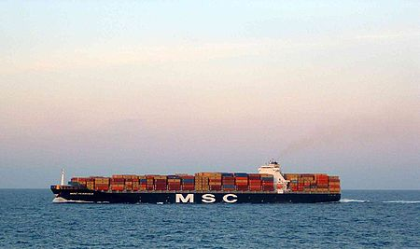
Fire
MSC Flaminia
Oil

Slide 20
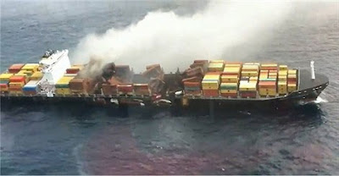

Slide 21
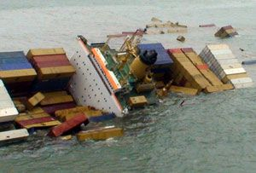
Cargo Overboard/Vessel Sinking
Comprehensive Environmental Response, Compensation, and Liability Act (CERCLA) Reportable Quantities
Oil
Section 103 of CERCLA requires the "person in charge" of a facility or vessel, as soon as he or she has knowledge of a release of a hazardous substance in an amount equal to or greater than an RQ, to report the release immediately to the National Response Center (NRC). The NRC number is 1-800-424-8802.

Slide 22
Dateline March 14, 2014
The Canadian Nuclear Safety Commission's on-site inspector has confirmed that all four canisters carrying hazardous material that fell while being moved off a cargo ship in Halifax are intact.
The CNSC expert arrived from Ontario Friday evening. He confirmed none of the containers leaked after falling from a height of six metres (19.69 ft.)
"Canadians should be reassured that Canada only allows shipments of uranium material for peaceful purposes in accordance with its international non-proliferation commitments on the peaceful use of nuclear substances," the CNSC said in a news release.
Halifax Regional Fire and Emergency said a large container was being moved just before 10 p.m. AT at the north-end dock when the bottom released, dropping up to four canisters filled with uranium hexafluoride.
Uranium hexaflouride, considered a "class seven" dangerous material, is a chemical compound used in the gas centrifuge process to enrich uranium, that is then used as reactor fuel or to arm nuclear missiles.
Oil

Slide 23
Management Tools
Know Your Clients
Proper Manifests/Bills of Lading
Spill Plans/Hazardous Material
Management Plans/Fire Control Plans
Properly Trained and Contracted Salvage,
Hazmat, and Environmental Vendors
Oil

Slide 24
Hull Damage

Slide 25
Grounding Issues
Coral
Sea Grass
Marine Sanctuaries
Some States have Compensation Tables based on Area Affected

Slide 26
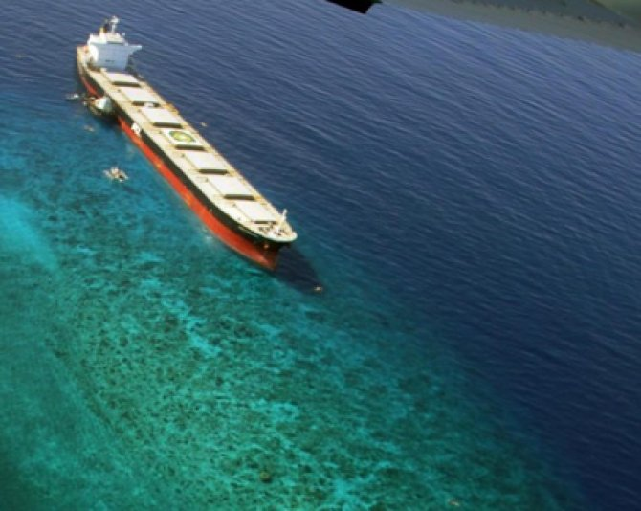
MV Double Prosperity

Slide 27
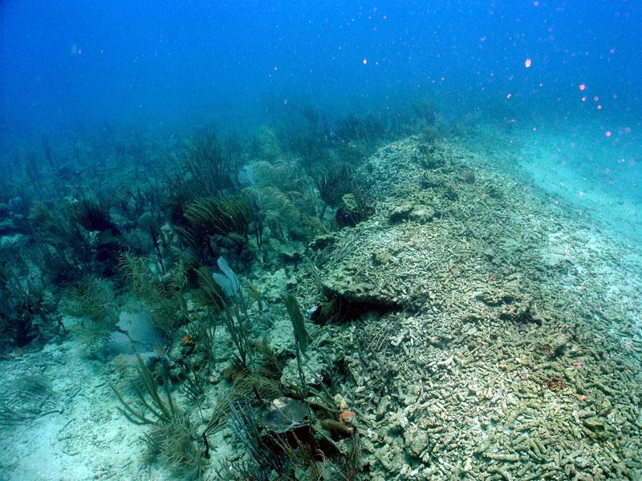

Slide 28
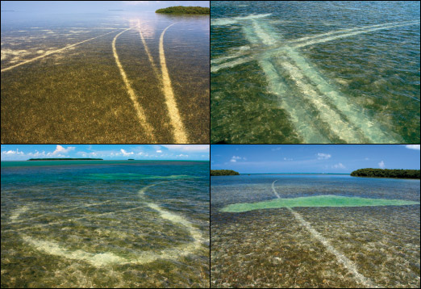

Slide 29
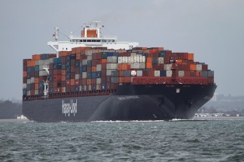

Slide 30
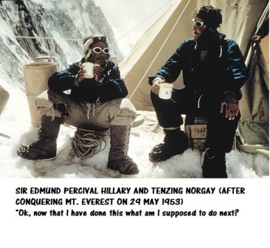

Slide 31
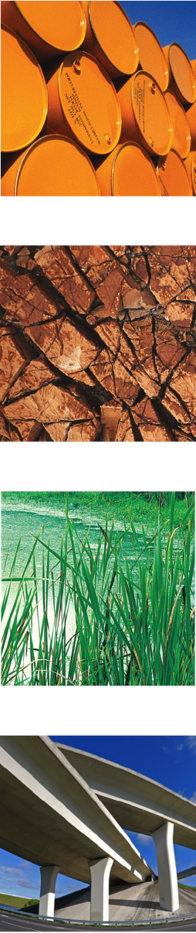
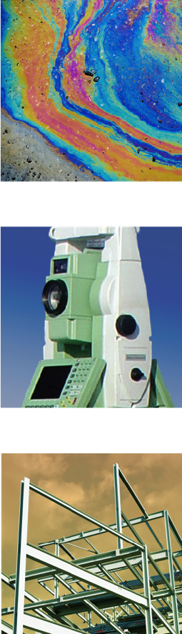


Slide 32
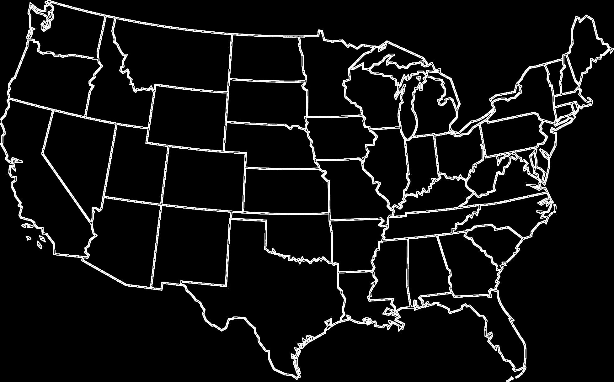
Regional Offices
Florham Park, NJ
Eatontown, NJ
Goodyear, AZ
Baton Rouge, LA
Daphne, AL
Wilmington, DE
New York, NY
Nashua, NH
Irvine, CA
Houston, TX

Slide 33
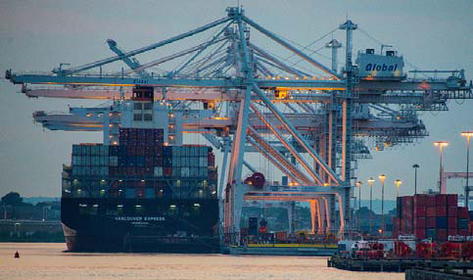
Matrix Marine Services
Insurance Damage and 3rd Party Claims
Dredging & Disposal
Piers, Wharves, Marinas, and Warehousing
Shore Protection
Warehousing
Submerged Utilities
Habitat Restoration/Mitigation
Hydrographic Survey
Marine Sampling
Permitting
Cost Estimating
Riparian/Tidal Surveys
Vessel Environmental Due Diligence
Biological Observers
FEMA Flood Insurance Claims
Sea Level/Resiliency Planning

Slide 34


Thank You
Questions

