Slide 1

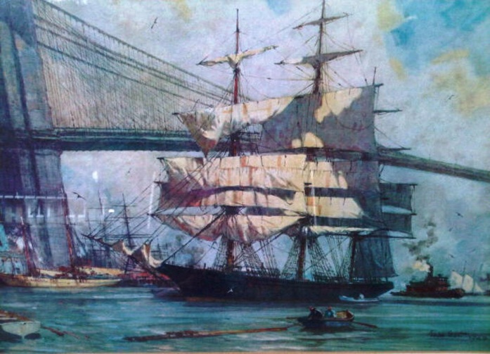
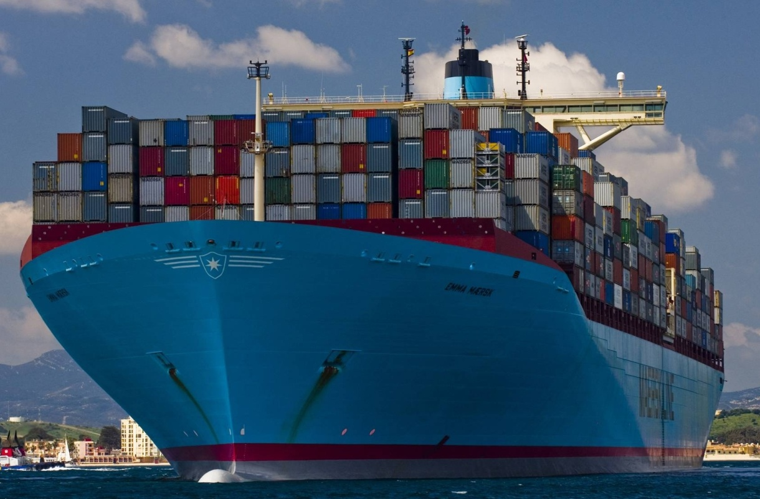

Mega Container Ship Casualties – General Average
An ancient practice meets a modern challenge

Slide 2

General Average: A quick review
General Average is an ancient principle that exists independent of insurance.
On a given Voyage:
"Expenses or sacrifices made by one interest (usually the shipowner) for the benefit of all will made good by the contributions of all"
This ancient principle has found its way into countless contracts of affreightment, hull and cargo policies etc

Slide 3
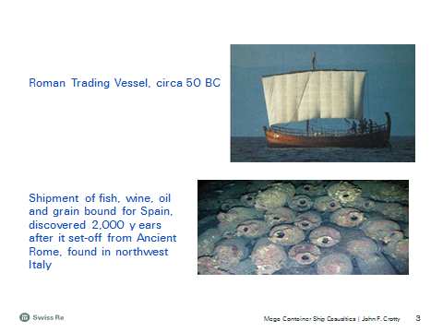
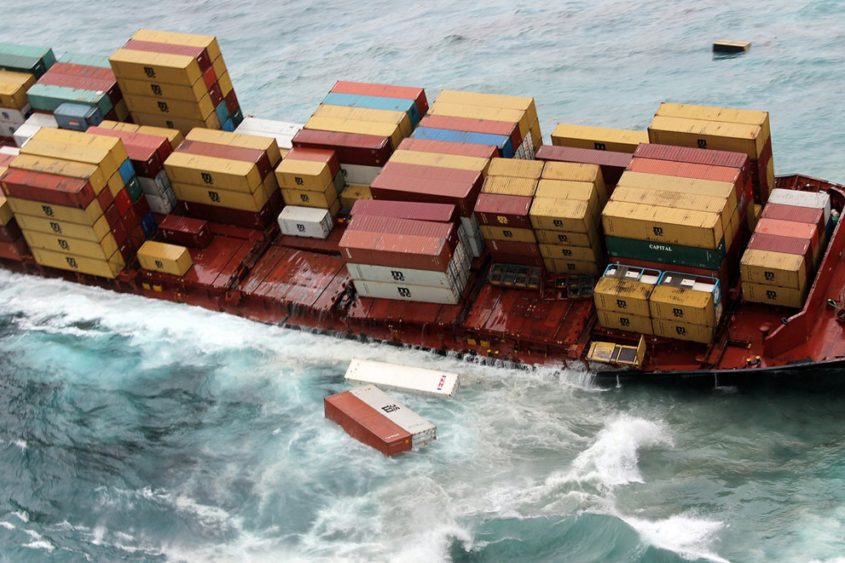
The more things change, the more they stay the same…

Slide 4

Immediate challenge: collection of GA and or Salvage Security prior to delivery of cargo at destination

Slide 5
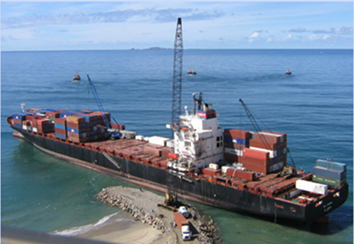
APL Panama (Ensenada, Mexico - Christmas Day 2005)
Grounded Dec. 25th 2005 -Refloated March 10th, 2006
Almost no damage
1805 containers on board -Approx. 1,300 discharged
1,445 cargo interests -Approx. 1,600 adjuster man hours

Slide 6
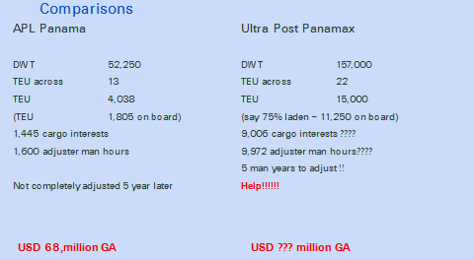
APL Panama:

Slide 7

Houston, we have another problem
The cargo contributory value book

Slide 8
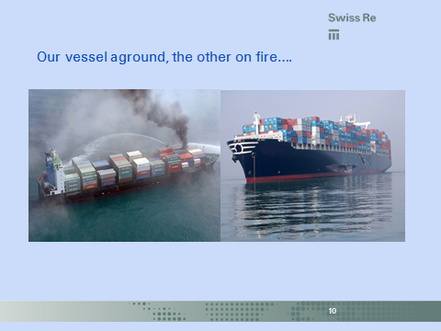
Our vessel aground, the other on fire…

Slide 9
The future is now, and the solution is
LANDMARK

Slide 10

Pulling Together
Hull Insurers
Cargo Insurers
P&I Clubs
Vessel Container Owners
Salvors

Slide 12
Legal notice
©2014 Swiss Re. All rights reserved. You are not permitted to create any modifications
or derivative works of this presentation or to use it for commercial or other public purposes
without the prior written permission of Swiss Re.
The information and opinions contained in the presentation are provided as at the date of
the presentation and are subject to change without notice. Although the information used
was taken from reliable sources, Swiss Re does not accept any responsibility for the accuracy
or comprehensiveness of the details given. All liability for the accuracy and completeness
thereof or for any damage or loss resulting from the use of the information contained in this
presentation is expressly excluded. Under no circumstances shall Swiss Re or its Group
companies be liable for any financial or consequential loss relating to this presentation.

